Slide 1
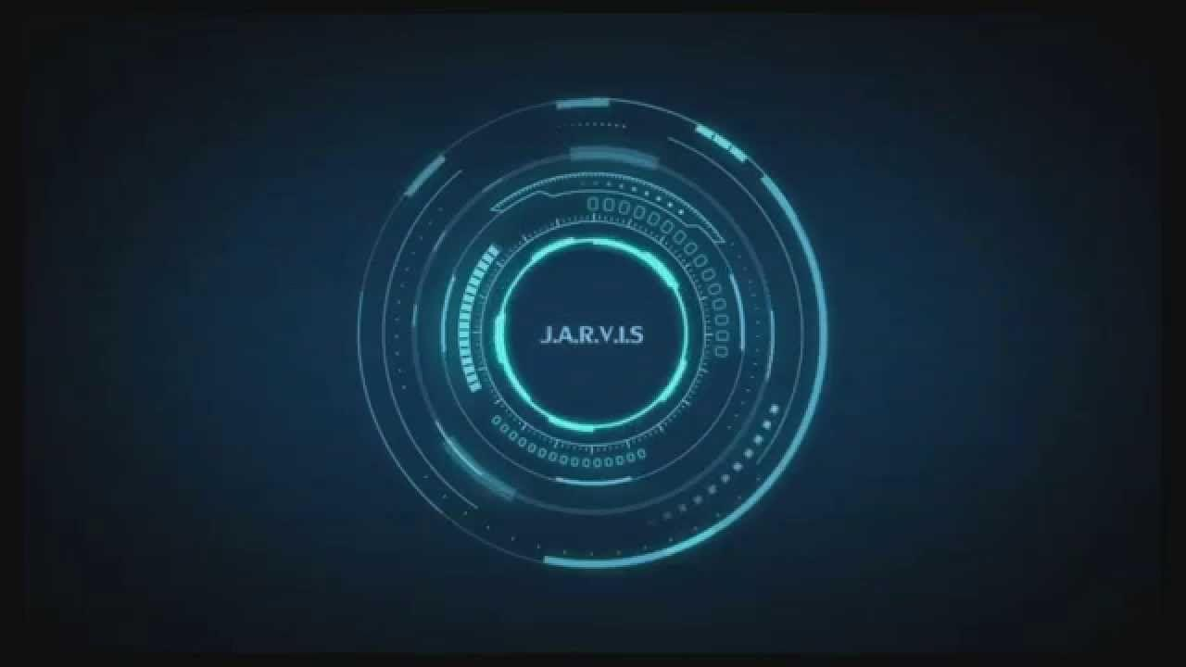
personal voice assistant using
python
Presented by :-
Anupam Dutta
Ritesh Saha
Birottom Biswas
Shubhranil Mazumder

Slide 2
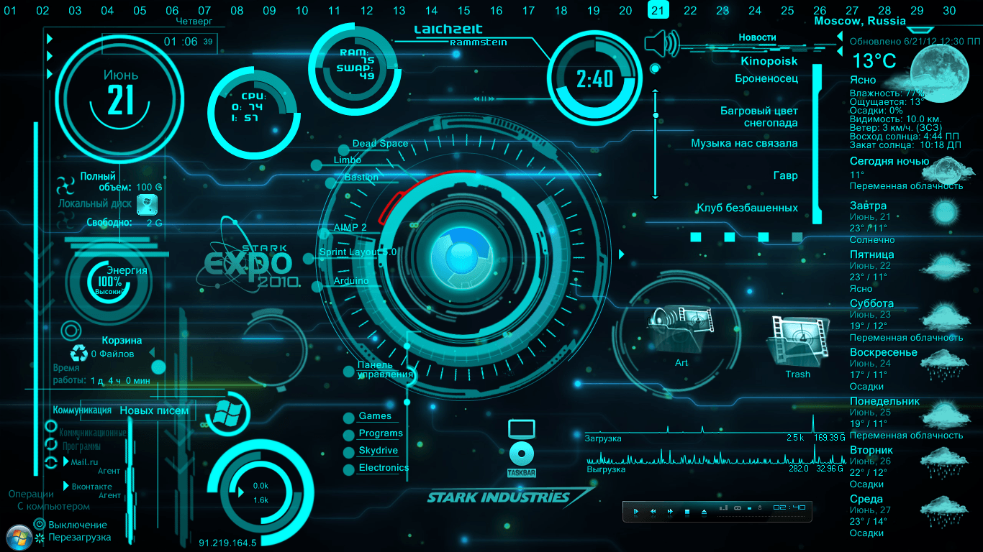

Slide 3
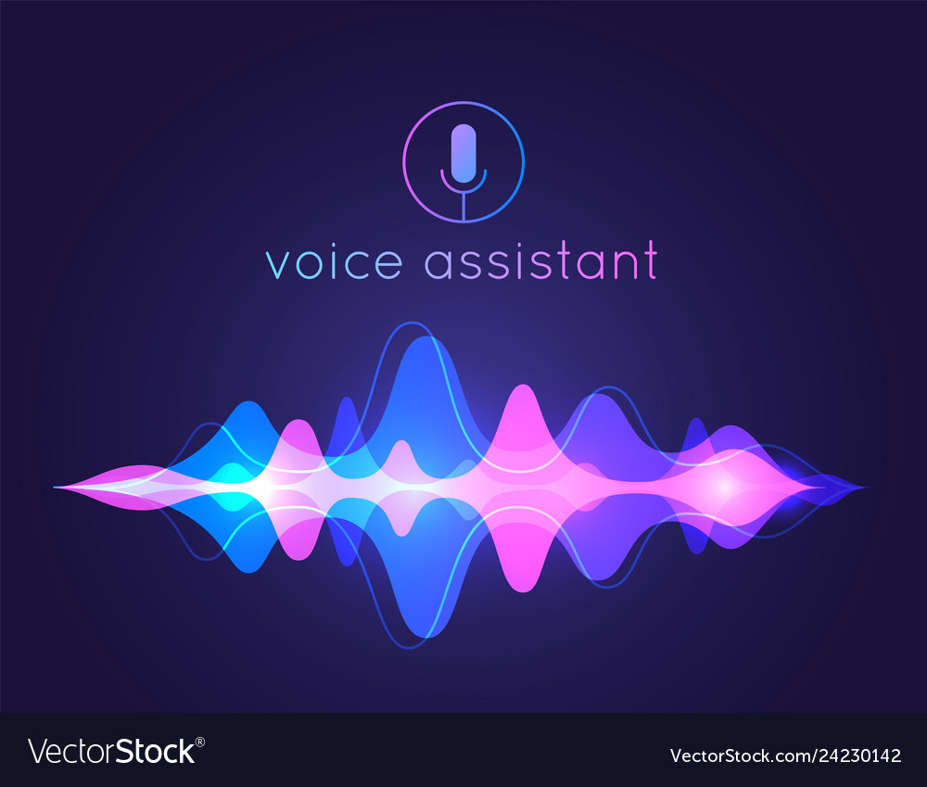
Introduction
A virtual assistant is an independent contractor who provides administrative services to clients while operating outside of the client's office. A virtual assistant typically operates from a home office but can access the necessary planning documents, such as shared calendars, remotely.
People employed as virtual assistants often have several years of experience as an administrative assistant or office manager. New opportunities are opening up for virtual assistants who are skilled in social media, content management, blog post writing, graphic design, and Internet marketing. As working from home has become more accepted for both workers and employers, the demand for skilled virtual assistants is expected to grow
In today’s era almost all tasks are digitalized. We have Smartphone in hands and it is nothing less than having world at your fingertips. These days we aren’t even using fingers. We just speak of the task and it is done. There exist systems where we can say Text Friend, “I will Call you Letter.” And the text is sent or any one may make call by saying “Call To Mr. Roy” That is the task of a Virtual Assistant. It also supports specialized task such as booking a flight, or finding cheapest book online from various e-commerce sites and then providing an interface to book an order are helping automate search, discovery and online order operations.

Slide 4
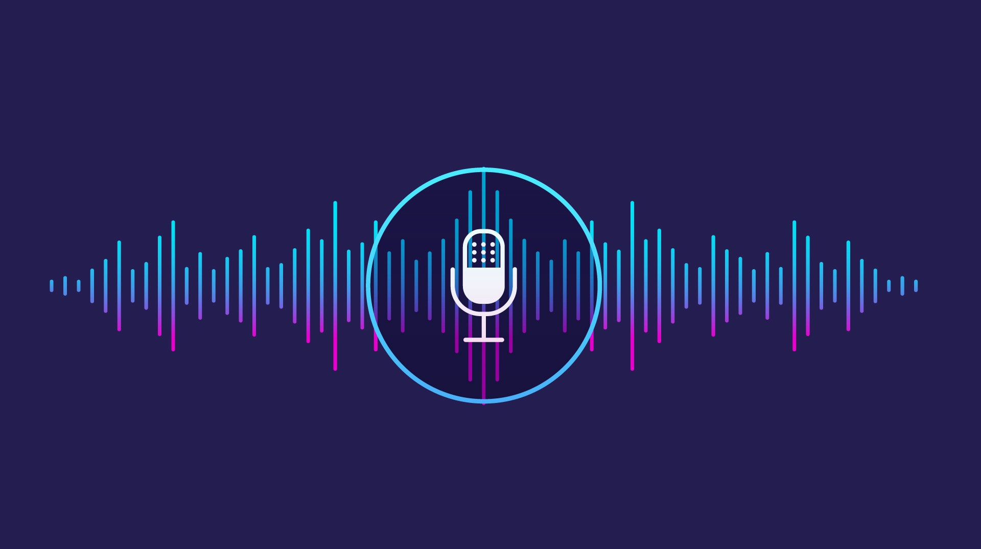
Uese
Uses
Make phone calls
Get information from Wikipedia
Send emails
Send Messages
Set Reminder
Ask Questions
Play Music & Videos

Slide 5
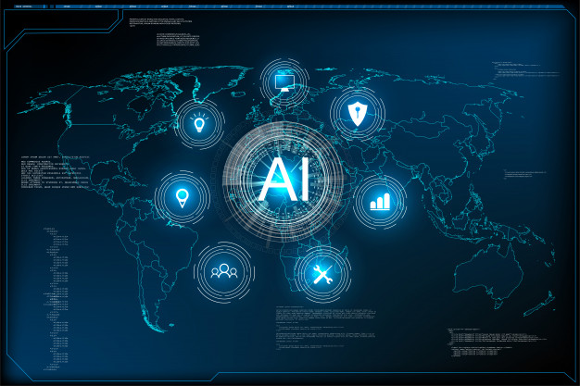
Technology Used
Python
Python is an interpreted, object-oriented, high-level programming language with dynamic semantics. Its high-level built in data structures, combined with dynamic typing and dynamic binding, make it very attractive for Rapid Application Development, as well as for use as a scripting or glue language to connect existing components together. Python's simple, easy to learn syntax emphasizes readability and therefore reduces the cost of program maintenance. Python supports modules and packages, which encourages program modularity and code reuse. The Python interpreter and the extensive standard library are available in source or binary form without charge for all major platforms, and can be freely distributed.

Slide 6
2. Spyder
Spyder is an open-source cross-platform integrated development
environment (IDE) for scientific programming in the Python language.
Spyder integrates with a number of prominent packages in the scientific
Python stack, SymPy and Cython, including NumPy, SciPy, Matplotlib, pandas,
IPython, as well as other open-source software.It is released under the MIT
license.Initially created and developed by Pierre Raybaut in 2009, since 2012
Spyder has been maintained and continuously improved by a team of scientific
Python developers and the community.
PyCharm
PyCharm is an integrated development environment (IDE) used in computer programming, specifically for the Python language. It is developed by the Czech company JetBrains (formerly known as IntelliJ). It provides code analysis, a graphical debugger, an integrated unit tester, integration with version control systems (VCSes), and supports web development with Django as well as data science with Anaconda.

Slide 7
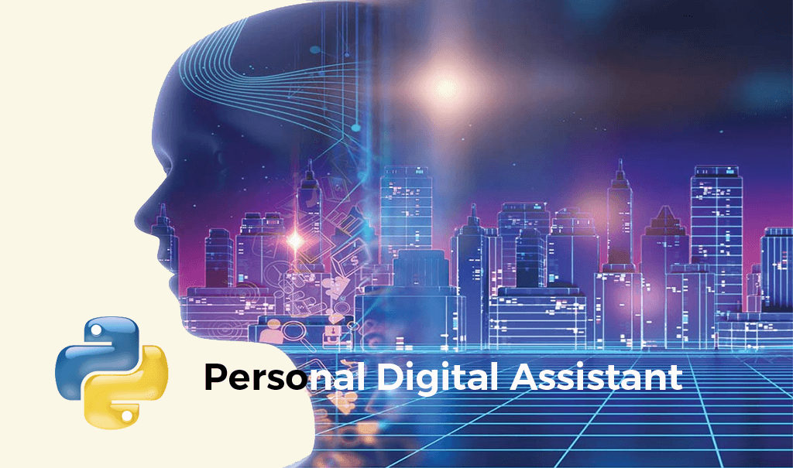
Used Modules
Speech Recognition: - Since we’re building an application of voice
assistant, one of the most important things in this is that your assistant recognizes your voice (means what you want to say/ ask). To install this module, type the below command in the terminal.
pip install SpeechRecognition
Web browser: - To perform Web Search. This module
comes built-in with Python.
Ecapture: - To capture images from your Camer.To
install this module type the below
command in the terminal.
pip install ecapture

Slide 8
Pyjokes: - Pyjokes is used for collection Python
Jokes over the Internet. To install this module type the below
command in the terminal.
pip install pyjokes
Datetime: - Date and Time is used to showing Date and Time. This module comes built-int with Python.
Twilio: - Twilio is used for making call and messages. To install this module
type the below command in the terminal.
pip install twilio
Requests: - Requests is used for making GET and POST requests. To install
module type the below command in the terminal.
pip install requests

Slide 9
Project code:
import pyttsx3 #pip install pyttsx3
import speech_recognition as sr #pip install speechRecognition
import datetime
import wikipedia #pip install wikipedia
import webbrowser
import os
import smtplib
engine = pyttsx3.init('sapi5')
voices = engine.getProperty('voices')
# print(voices[1].id)
engine.setProperty('voice', voices[0].id)
def speak(audio):
engine.say(audio)
engine.runAndWait()

Slide 10
def wishMe():
hour = int(datetime.datetime.now().hour)
if hour>=0 and hour<12:
speak("Good Morning!")
elif hour>=12 and hour<18:
speak("Good Afternoon!")
else:
speak("Good Evening!")
speak("I am Jarvis Sir. Please tell me how may I help you")
def takeCommand():
#It takes microphone input from the user and returns string output
r = sr.Recognizer()
with sr.Microphone() as source:
print("Listening...")
r.pause_threshold = 0.5
audio = r.listen(source)

Slide 11
try:
print("Recognizing...")
query = r.recognize_google(audio, language='en-in')
print(f"User said: {query}\n")
except Exception as e:
# print(e)
print("Say that again please...")
return "None"
return query
def sendEmail(to, content):
server = smtplib.SMTP('smtp.gmail.com', 587)
server.ehlo()
server.starttls()
server.login('youremail@gmail.com', 'your-password')
server.sendmail('youremail@gmail.com', to, content)
server.close()
if __name__ == '__main__':
wishMe()
while True:

Slide 12
query = takeCommand().lower()
# Logic for executing tasks based on query
if 'wikipedia' in query:
speak('Searching Wikipedia...')
query = query.replace("wikipedia", "")
results = wikipedia.summary(query, sentences=2)
speak("According to Wikipedia")
print(results)
speak(results)
elif 'open youtube' in query:
webbrowser.open("youtube.com")
elif 'open google' in query:
webbrowser.open("google.com")
elif 'open stackoverflow' in query:
webbrowser.open("stackoverflow.com")
elif 'play video' in query:
webbrowser.open("https://youtu.be/bq8Wvq-omRg")

Slide 13
elif 'play my video' in query:
music_dir = 'E:\video'
videos = os.listdir(music_dir)
print(videos)
os.startfile(os.path.join(music_dir, videos[0]))
elif 'the time' in query:
strTime = datetime.datetime.now().strftime("%H:%M:%S")
speak(f"Sir, the time is {strTime}")
elif 'who am i' in query:
speak(f"you are shubhranil")
elif 'who is my best friend' in query:
speak(f" soumya ghosh is your best friend")
elif 'who are you' in query:
speak(f" i am jarvis sir, your personal assistant")
elif 'open dev c' in query:
'C:\Program Files (x86)\Dev-Cpp'
elif 'open code' in query:
codePath = "C:\\Users\\Haris\\AppData\\Local\\Programs\\Microsoft VS Code\\Code.exe"
os.startfile(codePath)

Slide 14

elif 'email to nil' in query:
try:
speak("What should I say?")
content = takeCommand()
to = "onlysubhranil1998@gmail.com"
sendEmail(to, content)
speak("Email has been sent!")
except Exception as e:
print(e)
speak("Sorry my friend shubhranil. I am not able to send this email")
takeCommand()

Slide 15
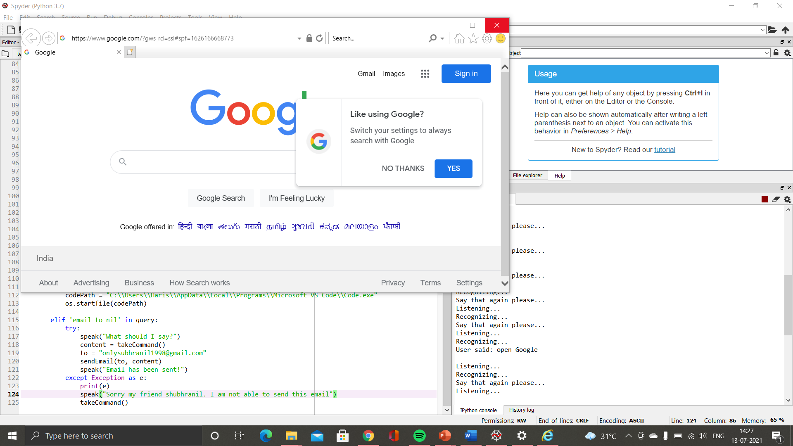
Opening Google using voice assistance

Slide 16
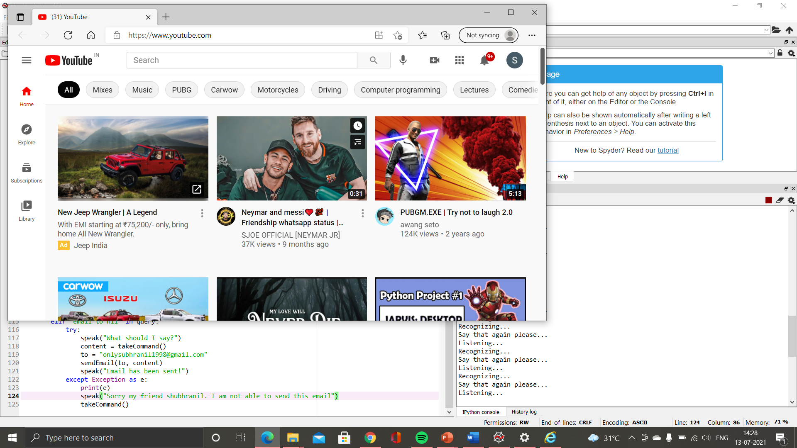
Opening YouTube using voice assistant

Slide 17
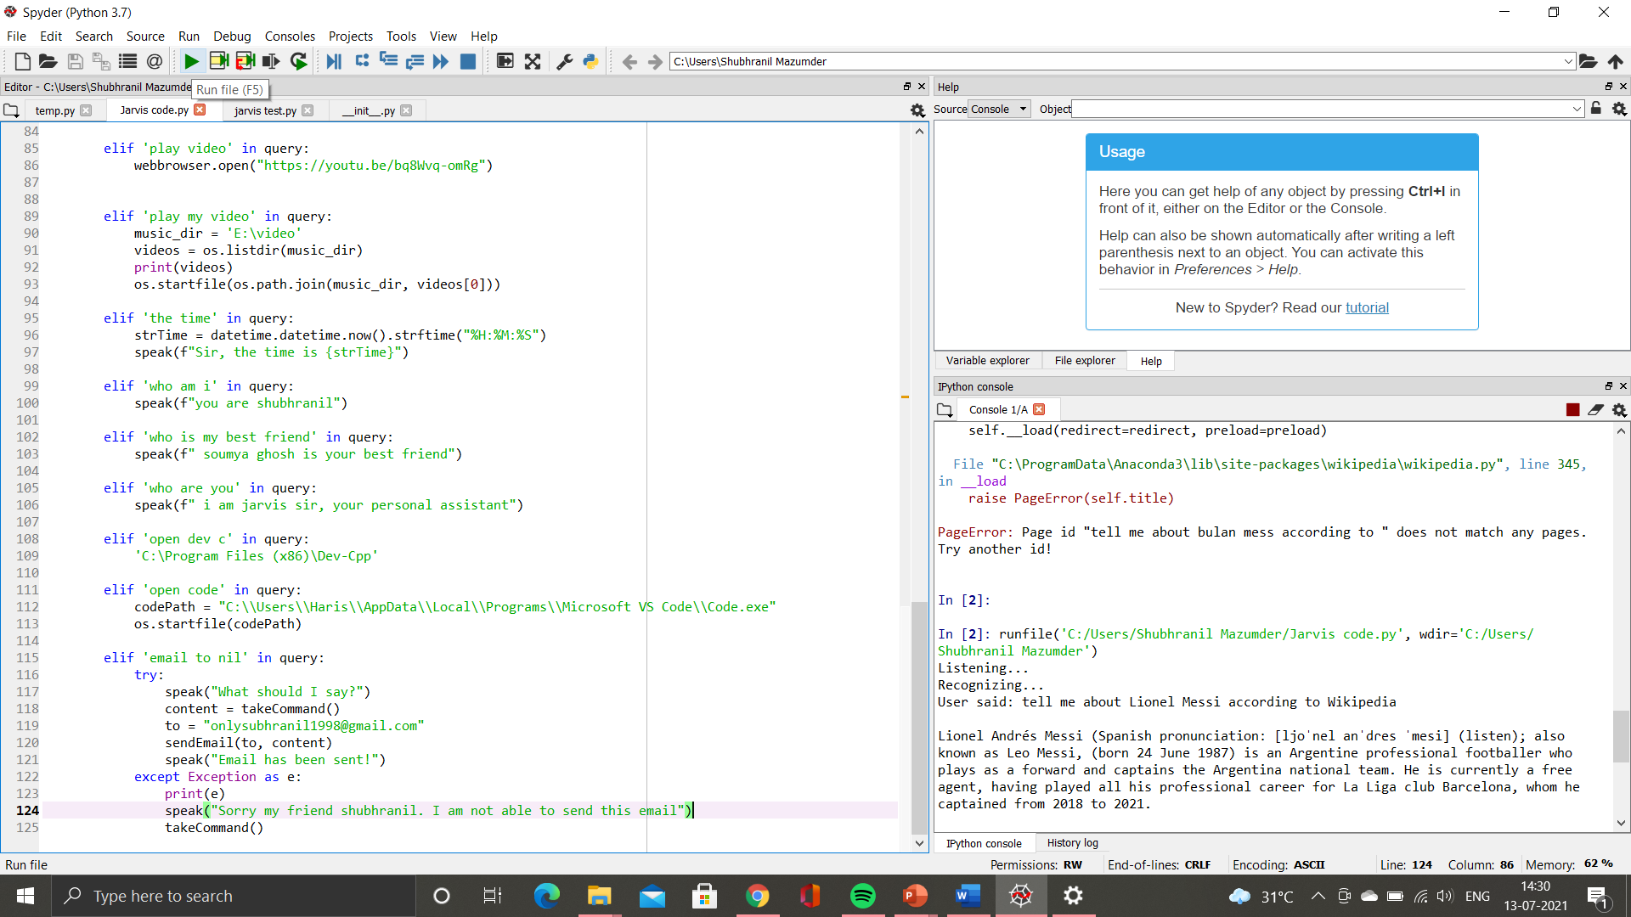
Telling about any person according to Wikipedia

Slide 18
Advantages
Enhances e-Commerce Marketing. ...
Provides 24/7 Customer Support. ...
Eradicates Language Barriers. ...
Helps Streamline Operations. ...
Saves Time by Automating Repetitive Tasks. ...
Enables Smart Offices. ...
Aids Hand-free Operation. ...
Conclusion.
Disadvantages
Lack of Accuracy and Misinterpretation.
Time Costs and Productivity.
Accents and Speech Recognition.
Background Noise Interference.
Physical Side Effects.

Slide 19
Conclusion
This examination speaks to an initial phase in investigating The potential job of remote helpers in programming Improvement Ventures finished by Virtual groups. This Project will be help for visually impaired and physically Challenge people. Instead, we will see a fragmented Marketplace emerges. It will be a market where you are Might into using default AI providers depending on the Hardware Purchase. This will lead to consumer friction and third-party solutions to remove incumbent solutions. This is how simple it is to build your own voice assistant. You can add many more features such as play your favorite songs, give weather details, open email application, compose emails, Restart your system, etc. You can integrate this application into your phone or tablet as well. Have fun exploring and developing
Your own Alexa/Siri/Cortana. Throughout the history of computing, user
Interfaces have become progressively natural to use. The screen and Keyboards were one step in this direction. The mouse and graphical user Interfaces were another. Touch screens are the most recent development. The next step will most likely consist of a mix of augmented reality, Gestures and Voice Commands. After all, it is often easier to ask a Question or have a conversation than it is to type something or enter Multiple Details in an online form. The more a person interacts with voice-activated devices, The more trends and patterns the system identifies based on the information it receives. Then, this data can be Utilized to determine user preferences and tastes, which Is a long-term selling point for making a home smarter?
Google and Amazon are looking to integrate voice-enabled Artificial intelligence capable of analyzing and responding To Human Emotion

Slide 20

Thank you

